Slide 1

HD3 Troubleshooting
Minimally Invasive Surgery Customer Service Department——Daniel

Slide 2
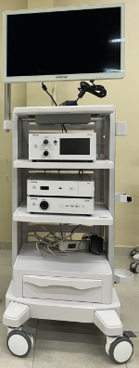
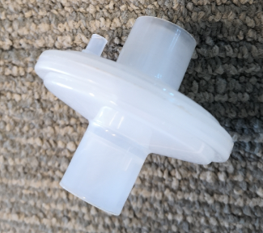
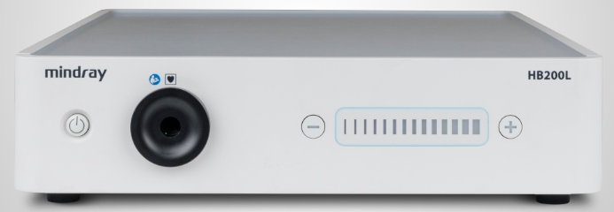
HD3 system setting ①
Precaution:
① DVI video cable connect between monitor and video processor.
27“ monitor ”DVI （in)“
HD3 “DVI (out)”
② Insufflator(HS-50F) always at the first layer with disposable filter.
③Light source always below 6 (brightness)
Below 6
Notes:
策略

Slide 3
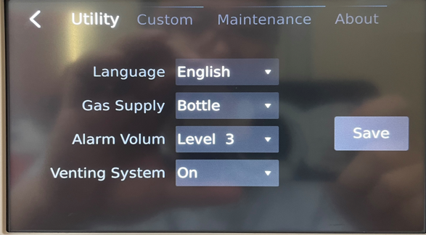
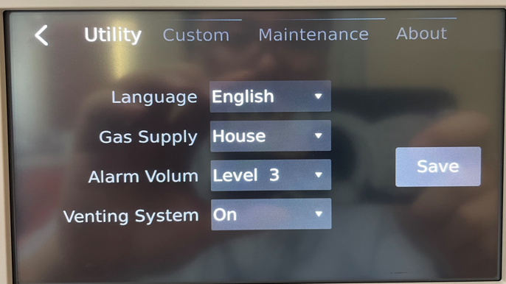
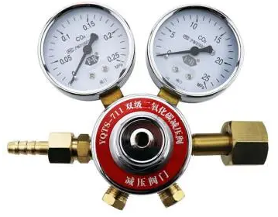
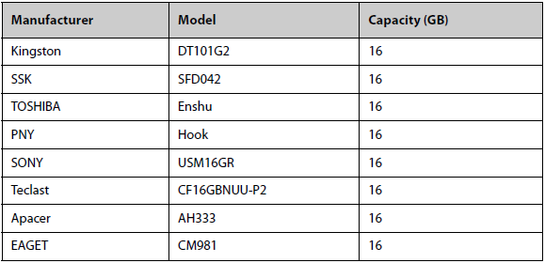
HD3 system setting ②
Precaution:
④ Insufflator mode selection
CO2 cylinder without pressure regulator——“Bottle”
CO2 cylinder with pressure regulator——“House”
Central CO2 supply system——“House”
⑤ A USB disk and portable HDD can be used for “REC” or “Photo”.
Brand | Type | Capacity
Kingston | DTSE9G2 | 128G
SanDisk | CZ880 | 128G
Toshiba | A3 | 2T
WD Elements | WDBU6Y0 040BBK | 4T
* Only FAT32 can be recognized by HD3.
Notes:
策略

Slide 4



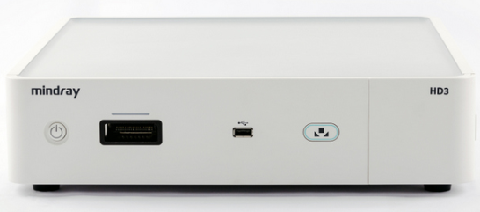


Troubleshooting——Black screen
Troubleshooting principle：
Exclude the possible reasons from basic step by step.
①Power check
LED of power switch:
Grey: No power
Orange: Power off
Blue: Power on
LED
Grey: No power
Orange: No signal at current channel
Green: With signal
LED bar of camera head:
Grey: No connection, no communication
Blue: connected and good communication
Notes:
策略

Slide 5
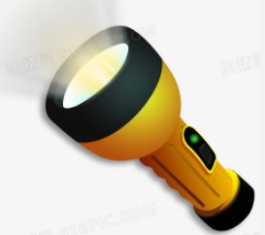
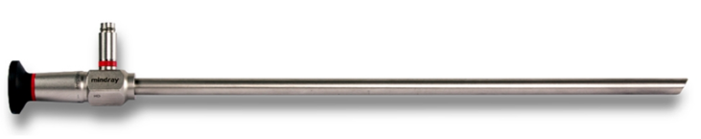

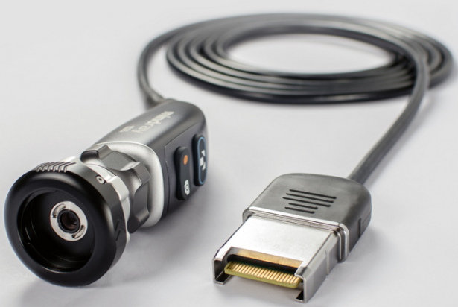
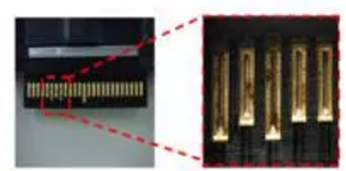
Troubleshooting——Black screen
Troubleshooting principle：
Exclude the possible reasons from basic step by step.
②Telescope and camera head check
Confirm that telescope can transit the image——Observe the image by eyepiece
Confirm that telescope can transit light——Check the light emit from distal end
Light emit from distal end
Can see image
Confirm that the cap of camera head was removed
Confirm that the pin of connector is good.
Notes:
策略

Slide 6
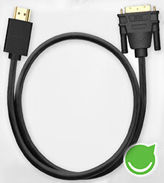
Troubleshooting——Black screen
Troubleshooting principle：
Exclude the possible reasons from basic step by step.
③Monitor
If LED shows grey，please check the power switch.
If LED shows orange, please check video signal.
Video cable quality, recommend DVI
Video connector. For monitor choose DVI in.
Select the correct video channel.
LED
Grey: No power
Orange: No signal at current channel
Green: With signal
If LED shows green，please check HD3.
Cross check is the fast way to exclude the monitor issue.
Another HD3 can do the cross check
A laptop with DVI output can do the cross check.
HDMI➡DVI adapter can be used.
Notes:
策略

Slide 7
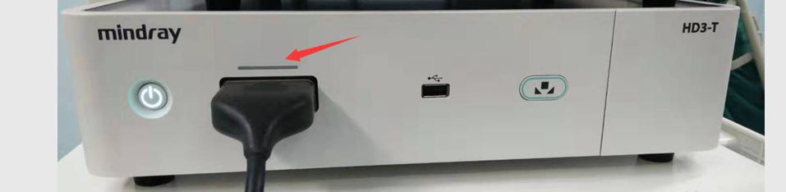
Troubleshooting——Black screen
Troubleshooting principle：
Exclude the possible reasons from basic step by step.
④HD3
If LED bar above camera head connector shows grey，that means the connection between camera head and HD3 is poor.
Power off HD3, reconnect the camera head and power on again.
If LED bar above camera head connector shows blue，that means the connection between camera head and HD3 is good.
The problem is caused by HD3 internally.
Need open top cover and replace the CCU unit.
Notes:
策略

Slide 8
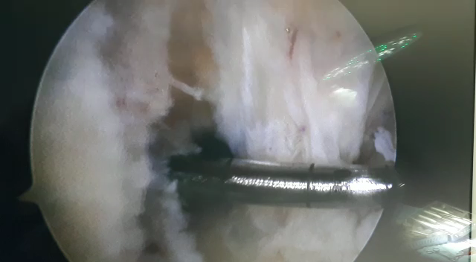
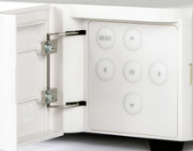
Troubleshooting——Flashing issue
Background:
The image also flashing when inserting surgical instrument during Hysteroscopy, Arthroscopy or Urological surgery.
Reason: Because the inappropriate surgery scene and AE speed were selected. HD3 try itself adjust the image brightness always cause the flash issue.
Countermeasure:
Step1：Open the window right side on the front panel of HD3.
Notes:
策略

Slide 9
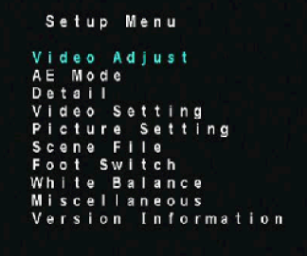
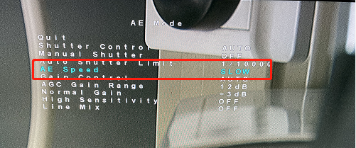
Troubleshooting——Flashing issue
Step2: Press “menu” button and call the OSD menu on the monitor.
Step4：Change AE speed from“fast“ to ”slow“
Step5: Then you have two choices.
You can select scene mode as ENT. Or you can select scene mode as SDS.
Either one is available if it can satisfy the customer with better image.
Step3：Use arrow key to select “AE Mode“
Notes:
策略

Slide 10
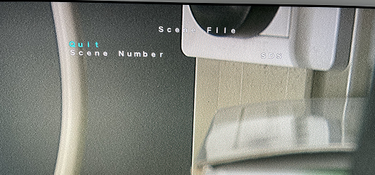
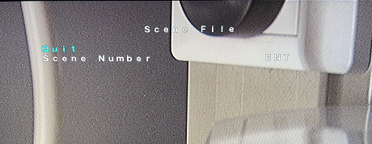
Troubleshooting——Flashing issue
Step6: Use arrow key to select and enter “Scene File”
Step7: select and confirm the scene number.
Note：If the problem still exists, please contact Mindray service engineer.
Notes:
策略

Slide 11
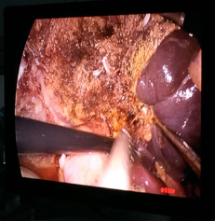
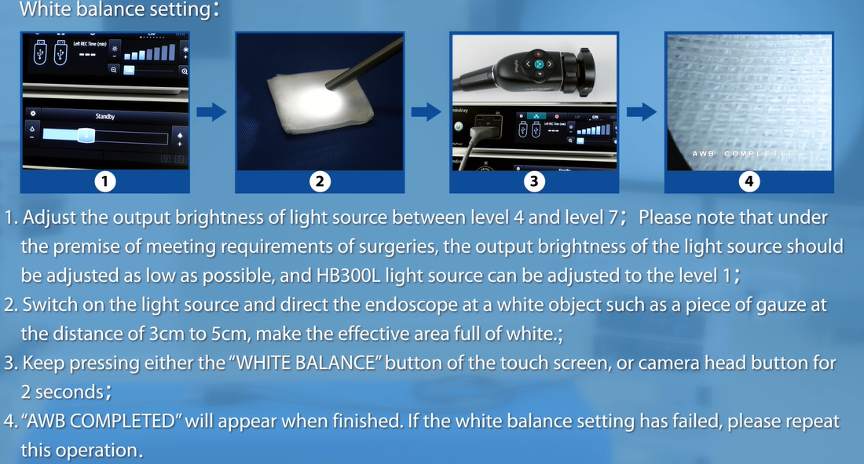
Troubleshooting——Color distortion
Background:
The image was reported that has a color distortion or the color was not satisfied by customer during surgery.
Reason: There could be many reasons cause this issue. The major reason is “white balance”, “video cable”, “Wrong setting”.
Countermeasure:
Conduct correct white balance.
※ Three principles:
Pure white,
Reasonable distance,
Proper brightness
Notes:
策略

Slide 12
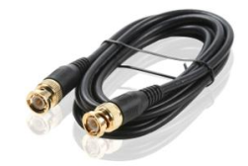
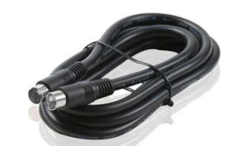
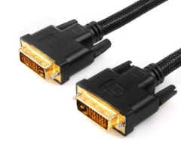
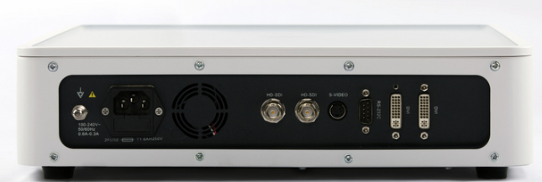
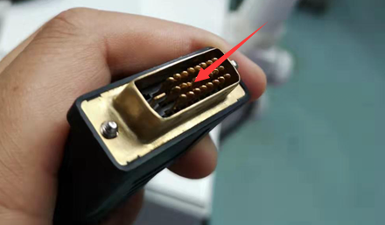
Troubleshooting——Color distortion
Check video cable
Check the video cable appearance, especially the pin of DVI.
SDI
S-video
DVI
Check HD3 and monitor setting
Since inappropriate setting will also cause the color different. It’s recommend to initial the HD3 and monitor.
Set correct surgery scene
The inappropriate surgical scene will also cause color abnormal. Please set the correct surgical scene.
Notes:
策略

Slide 13


Troubleshooting——Recording
Background:
Customer feedback the REC or photo function can’t be used.
Reason: The HD3 system is not built in “Windows”. It can’t compatible with as many USB disks as laptop can.
Countermeasure:
Only FAT32 can be recognized by HD3.
Try to use the models tested by Mindray or popular ones
Use “VLC” or “Pot player” to play the recoding video.
Brand | Type | Capacity
Kingston | DTSE9G2 | 128G
SanDisk | CZ880 | 128G
Toshiba | A3 | 2T
WD Elements | WDBU6Y0 040BBK | 4T
Notes:
策略

Slide 14
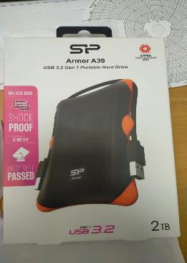
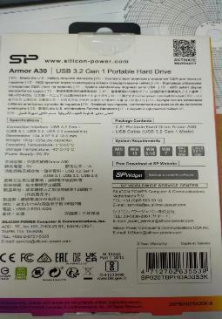
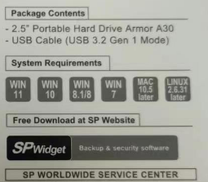
Troubleshooting——Recording
Background: A brand new portable HDD can’t be recognized by HD3.
Analysis: Nowadays, the HDD or USB disk may has internal software.
Although it’s brand new, the internal software can’t be recognized by HD3.
Countermeasure: Use laptop to format the HDD as FAT32.

Slide 15
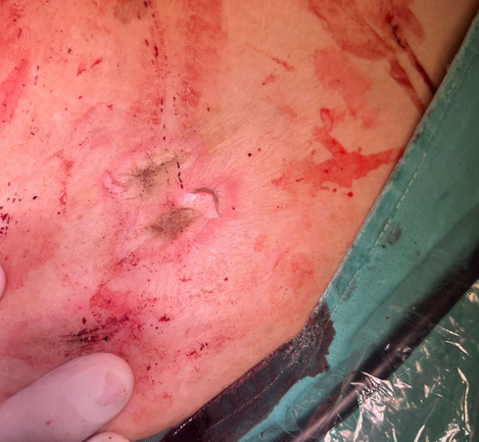
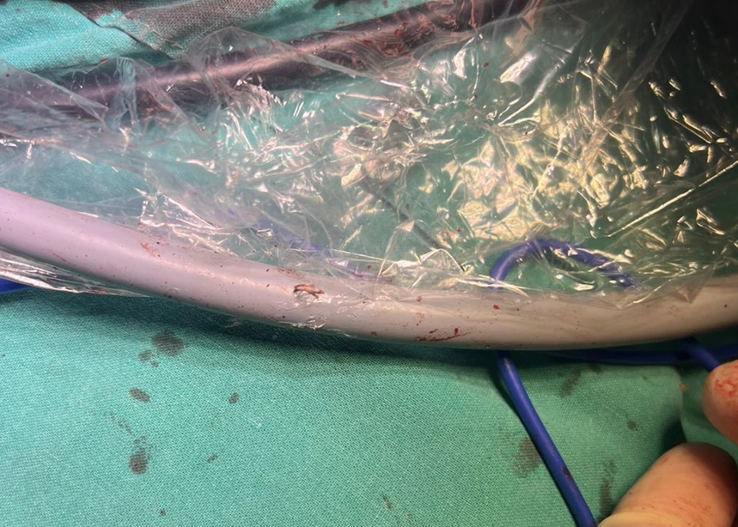
Troubleshooting——Light Guide Cable
Background:
Customer feedback the light guide cable burns the patient’s skin during procedure
Cause:
Optical fibers inside the light guide cable break, and heat accumulated inside the cable, when it contacts the patient, it burns the skin.
No significant damage on the light guide cable

Slide 16
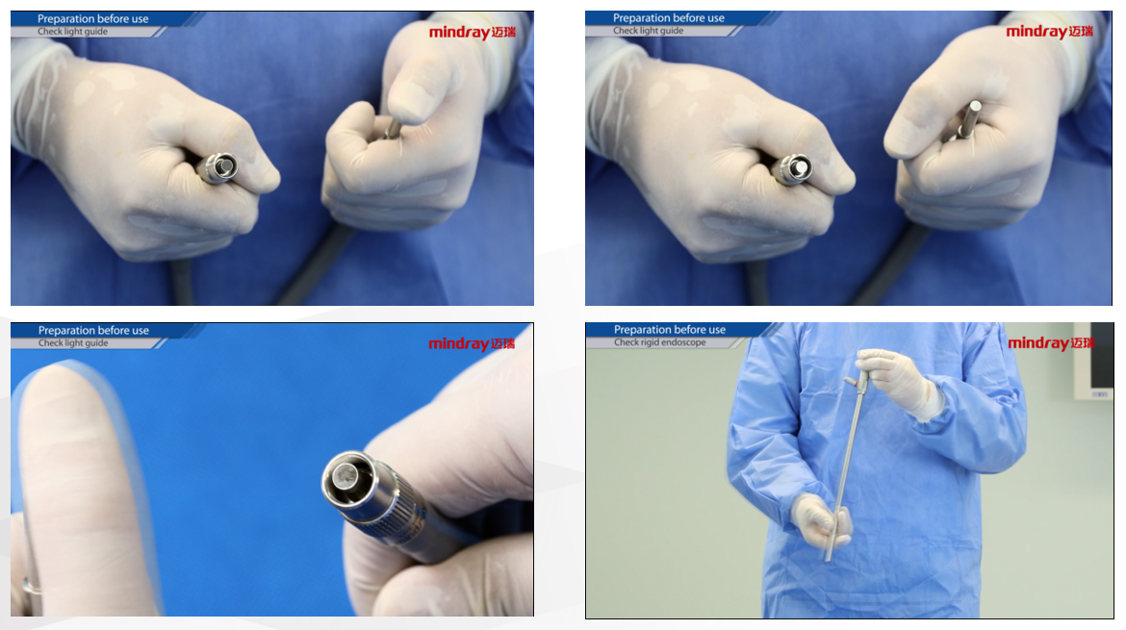
Troubleshooting——Light Guide Cable
Preventive action:
-Inspect the light guide cable before procedure
-Do not use the light guide cable if 1/3 optical fibers are broken.

Slide 17
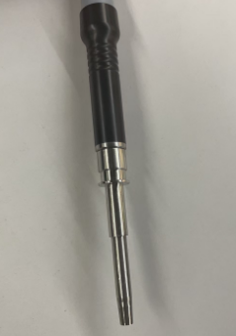
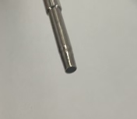
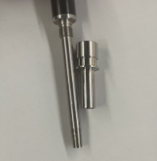
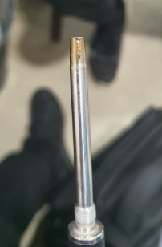
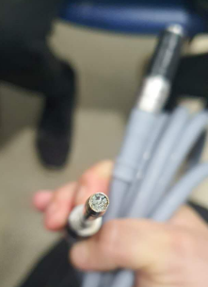
Troubleshooting——Light Guide Cable
A limit stopper to protect the tip
The light guide has a limit stopper. This stopper can protect the light guide not to insert too deeply. But if you remove it to insert to other light source, the risk is it may inset too much and damage the tip glass.

Slide 18
HD3 System Upgrade

Slide 19
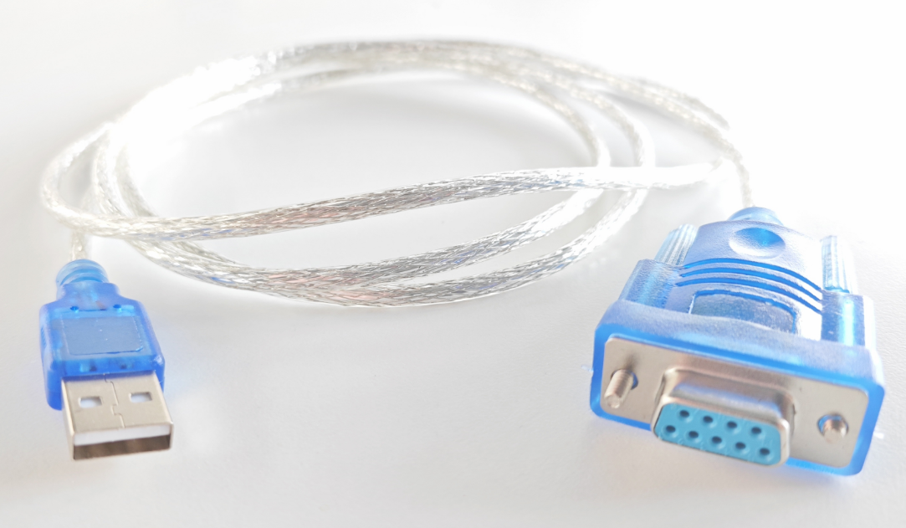
HD3 System Upgrade
Step 1: Preparation
Prepare a USB to RS232 serial port cable;
Notes:
策略

Slide 20
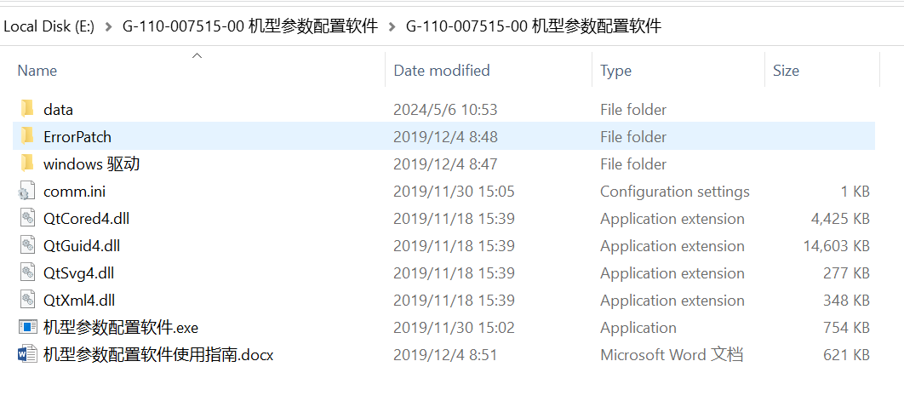
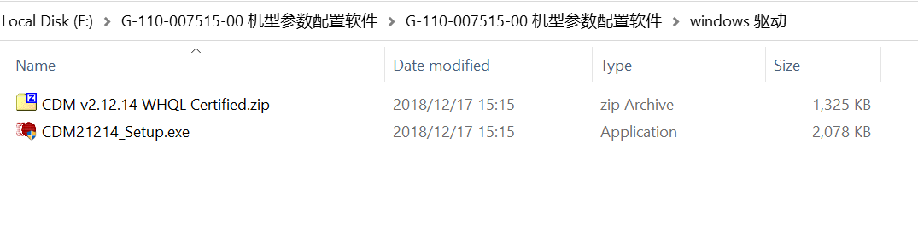
HD3 System Upgrade
Step 1: Preparation
Download “G-110-007515-00” file to your PC, and unzip it.
The route of the driver installation file:
G-110-007515-00 机型参数配置软件>G-110-007515-00 机型参数配置软件>windows 驱动>CDM21214_Setup.exe
Driver installation file
Notes:
策略

Slide 21
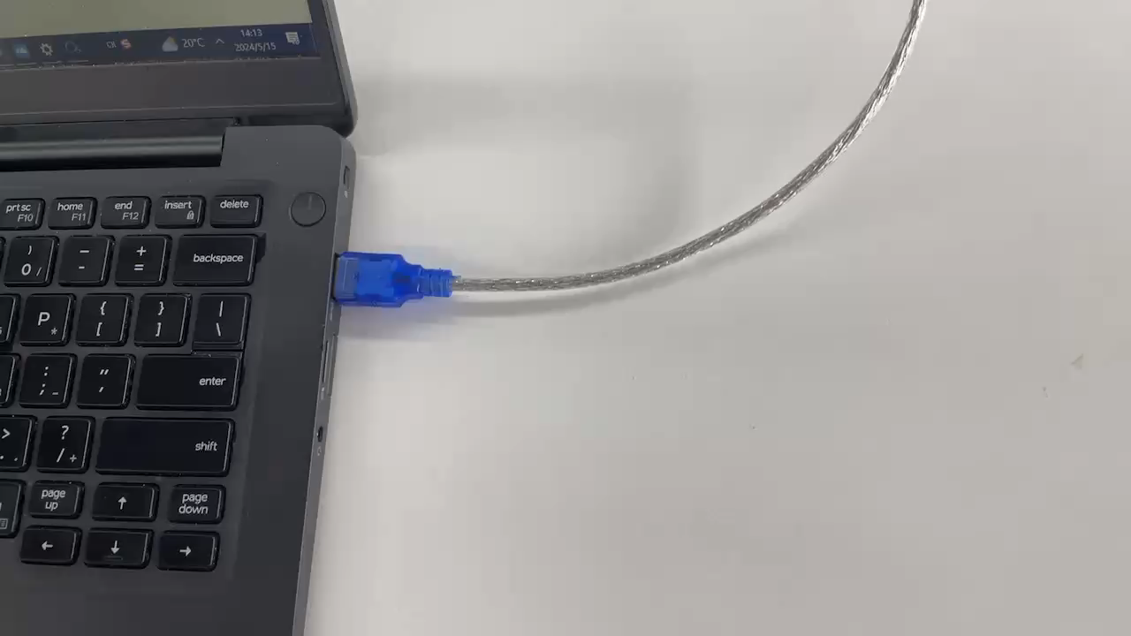
HD3 System Upgrade
Step 2: Connect PC and HD3 Video Processor
Connect the RS232 socket on the rear panel of HD3 video processor with PC by using the prepared cable.
Notes:
策略

Slide 22
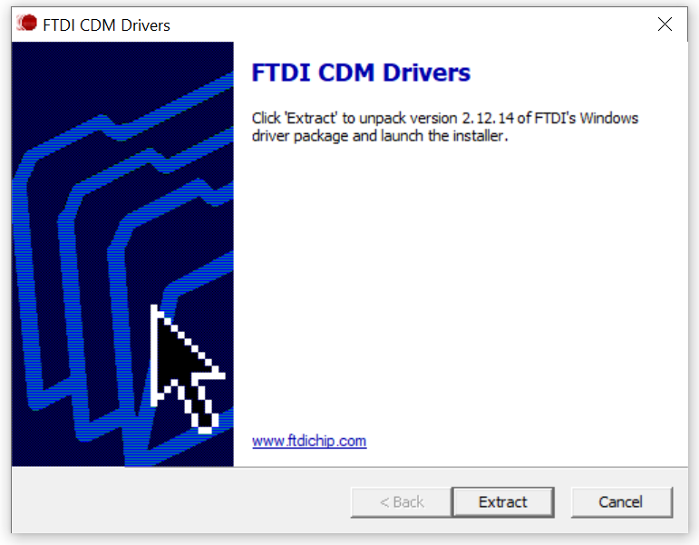
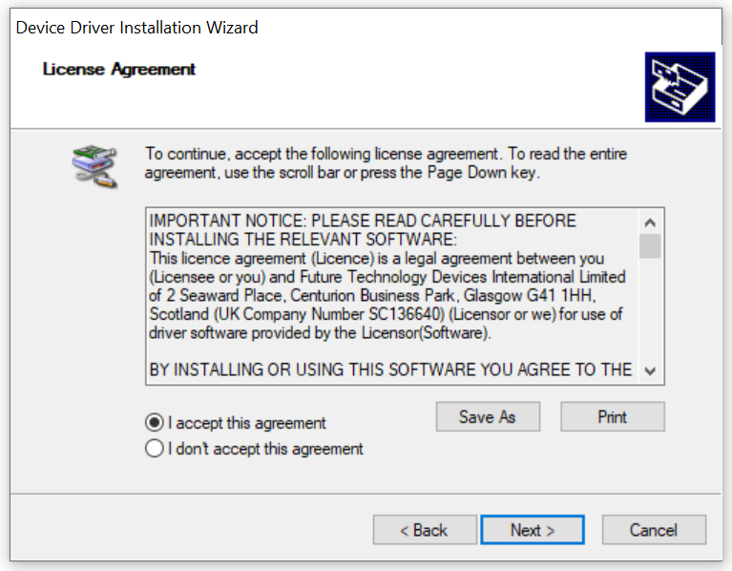
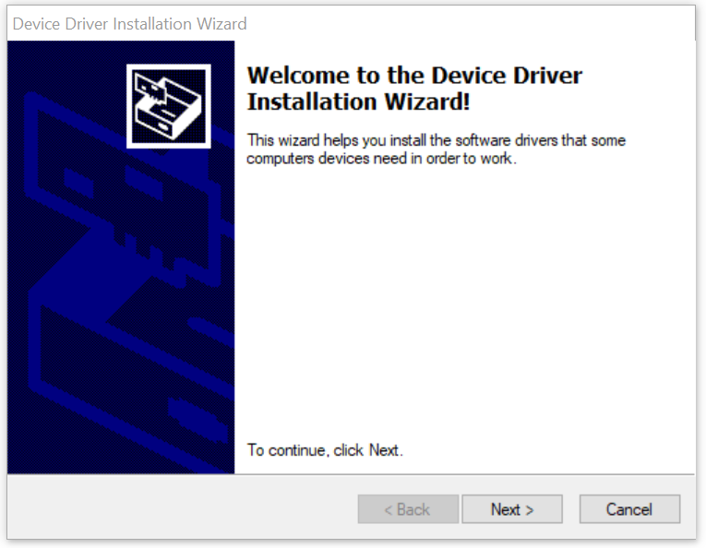
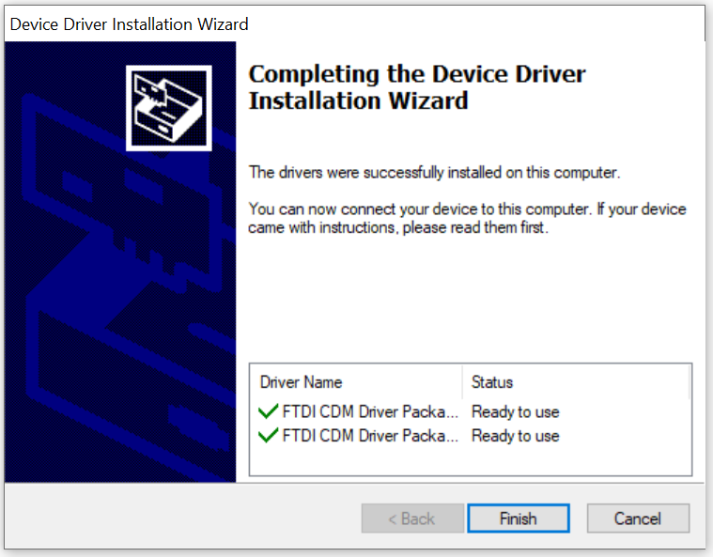
HD3 System Upgrade
Step 3: Install the Driver
1. Double click “CDM21214_Setup.exe”, click “Extract”
3. Select “I accept this agreement”, and click “Next”
2. Click “Next”
4. Click “Finish”
Notes:
策略

Slide 23

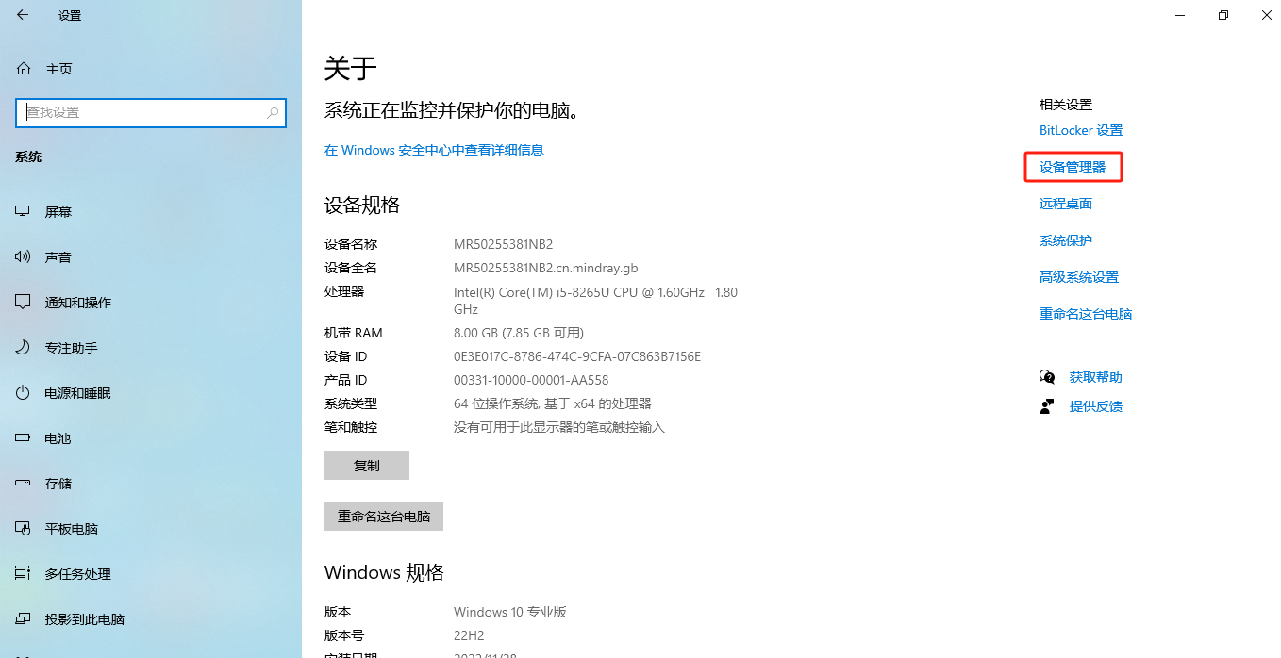
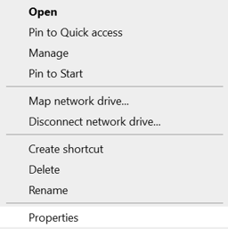

HD3 System Upgrade
Step 4: Confirm the USB SERIAL Port(COMX) (X can be 1,2,3,4,5…… )
1. Right click “this PC”,
3. Select “Microsoft. Device Manager”
2. Click “Properties”
4. Find USB-SERIAL PORT (COMX)
In this case, X is 5
Notes:
策略

Slide 24

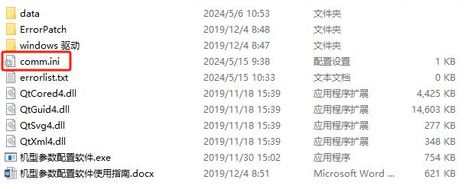
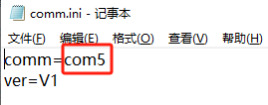
HD3 System Upgrade
Step 5: Set the port
Open “comm.ini” by Office Note
Change COMM=COM5. (Pls change according to the port number confirmed in previous step)
Notes:
策略

Slide 25

HD3 System Upgrade
Step 6: Upgrade the software
Double click “机型参数配置软件.exe”
Select corresponding model of the video processor to upgrade the software
After upgrade, turn off the video processor
Restart the video processor, change scene file from 1 to 4
Turn off the video processor, upgrade is completed
Notes:
策略

Slide 26

Thank you
Notes:
That’s all.

